Slide 1
Sensia Measurement
JISKOOT Blending Systems Training –
Week 2 Day 1
Duane Rowan – Product Champion

Slide 2
Agenda
Week 2
Blending Market
Blending Sales Process
Blending Sales Tools
Blending Sales Case Studies

Slide 3
This will be an ongoing process of learning.
 | Jon Moreau (mentor) | Duane Rowan (mentor) | Gary Potten (mentor) | Mark Doust (tech advisor)
David Aldous (M) |  |  | X | X
Ateeth Saligram (PA) |  |  | X | X
Omar El Raggal (PA) | X |  |  | X
Madan Kumar (PA) | X |  |  | X
Ian Dowdell (M) |  | X |  | X
Brad Moes (PA) |  | X |  | X
Braden Montalvo (M) |  | X |  | X
James Morris (PA) |  | X |  | X
Steven Cochran (PA) |  | X |  | X
Daniel Garcia (M) |  | X |  | X
Laura Huerfano (M) |  | X |  | X
Marcio Cruz (PA) |  | X |  | X
Eduardo Mota (PA) |  | X |  | X

Slide 4
Last Week
All week 1 presentations have been uploaded
All week 1 recordings were uploaded last night

Slide 5
Market Data – Terminal Capacity

Slide 6
Market Data – Refinery Capacity

Slide 7
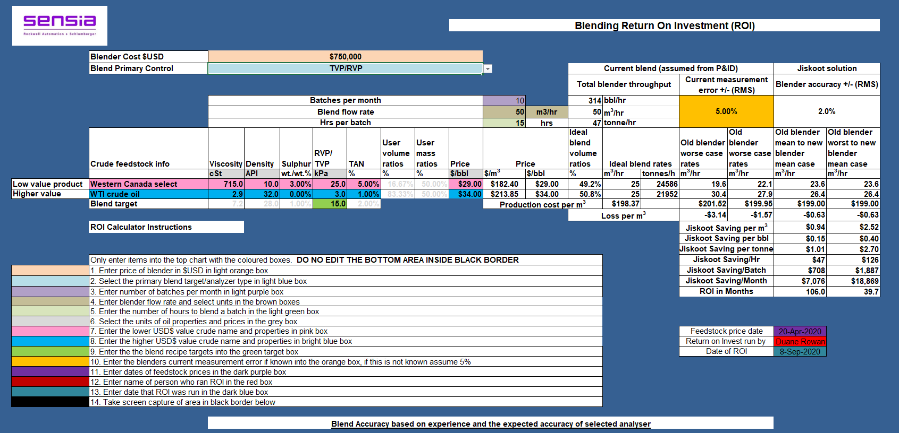
Sales Tools
We have made major progress on updating the Sales ROI Calculator

Slide 8
Market Information

Slide 9
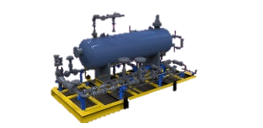
Where are blending systems found?
LNG Storage
LNG Tanker
Wellhead
Gas Processing
LNG Liquefaction
Gas Compression
LNG Gasification
LNG Transport
Allocation Testing
NGLs
Butane
LPG
Refined Fuels Terminal
Oil Processing
Oil Gathering
Refined Fuels Terminal
Oil Terminal
Oil Refinery
Refinery Terminal
Refined Fuels Terminal
Oil Terminal

Slide 10
Found in these key areas
Crude Oil Terminals
Where different crude types come together
Critical Infrastructure Storage Hubs
Where third party terminal that is supplying multiple refineries
Crude Oil Refineries
That are using a variety of crude types
Refined Terminals
Where they are supplying a variety of products
Import/Export Terminals
Where they are bringing in fuels that may need to be adjusted to meet market demands
Marine Fuel Terminals/Barges

Slide 11
Crude Oil Terminals

Slide 12
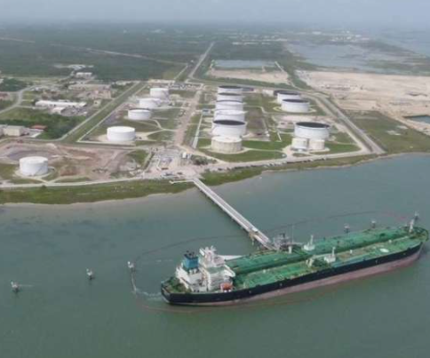
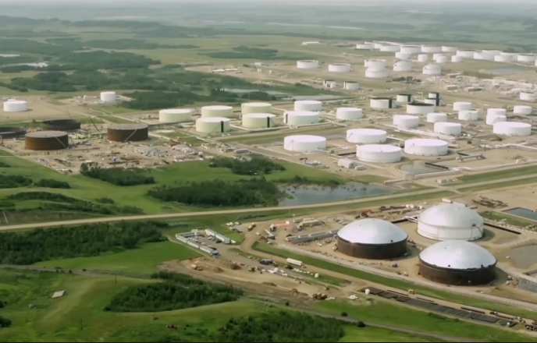
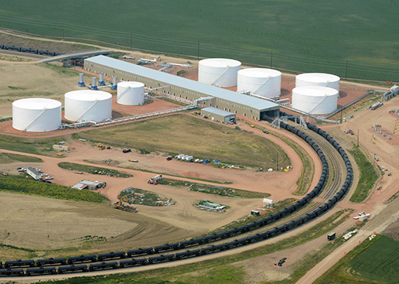
Crude Oil Terminal Market
Blending market is often associated with Terminals that are handling refineries that are processing a variety of oils, but also in refineries that are major hubs that handle a large variety of crude oils, condensates and other feedstocks
The key areas for terminals that are:
Crossroads of heavy & light products
Crossroads of sweet & sour
inlet of refineries processing variety of crudes

Slide 13
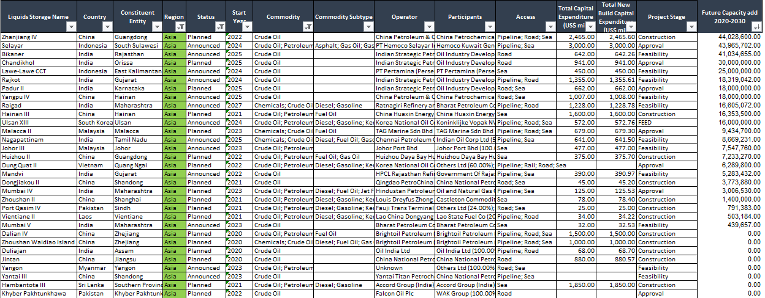
Asia Pacific

Slide 14
EMEA

Slide 15
NAM

Slide 16
LAM

Slide 17
Refined product terminals

Slide 18
Refined Product Terminal Market
Blending market is often associated with Terminals that are exporting or transporting refined products
The key areas for terminals that are:
Major Export Hubs
Regions with high concentration of refineries

Slide 19
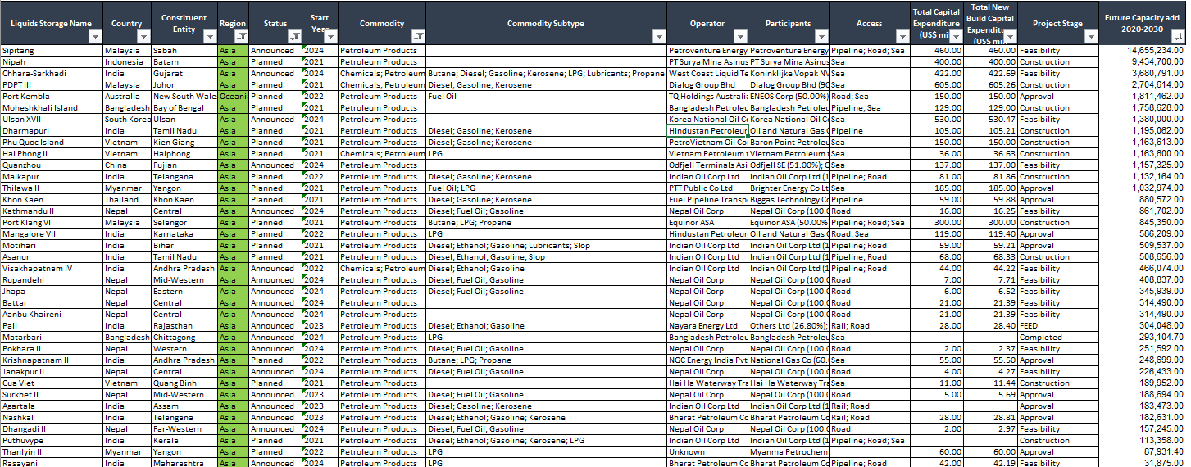
Asia Pacific

Slide 20
EMEA

Slide 21
NAM

Slide 22
LAM

Slide 23
Marine Fuel Oil Terminals

Slide 24
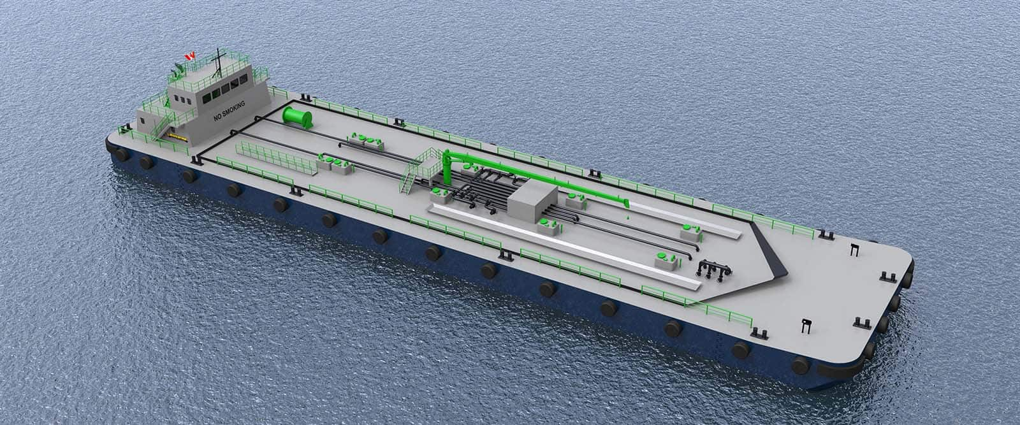
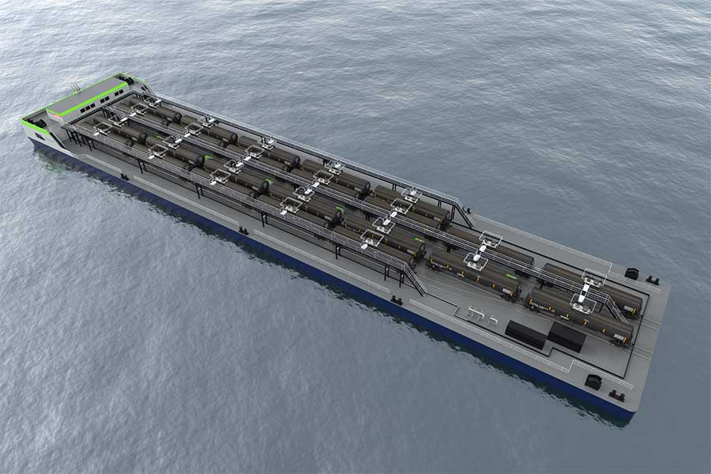
Marine Fuel Oil Terminal Market
Marine Fuel Oil Blending market is often associated with any large shipping terminals where cargo enters or exits a country.
The key areas for terminals that are:
Major sea import/export shipping hubs
Major Crude Transport via ship
Major Refined Product import/export

Slide 25
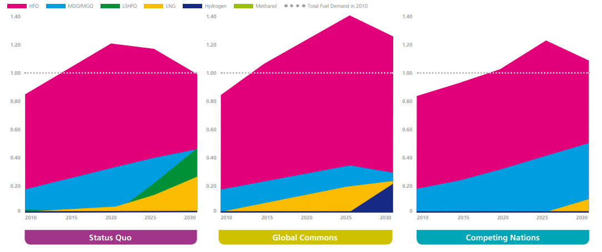
Global Fuel Consumption

Slide 26
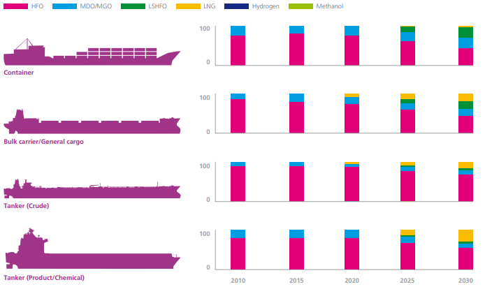
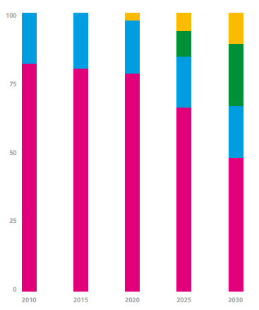
Fuel Mix

Slide 27
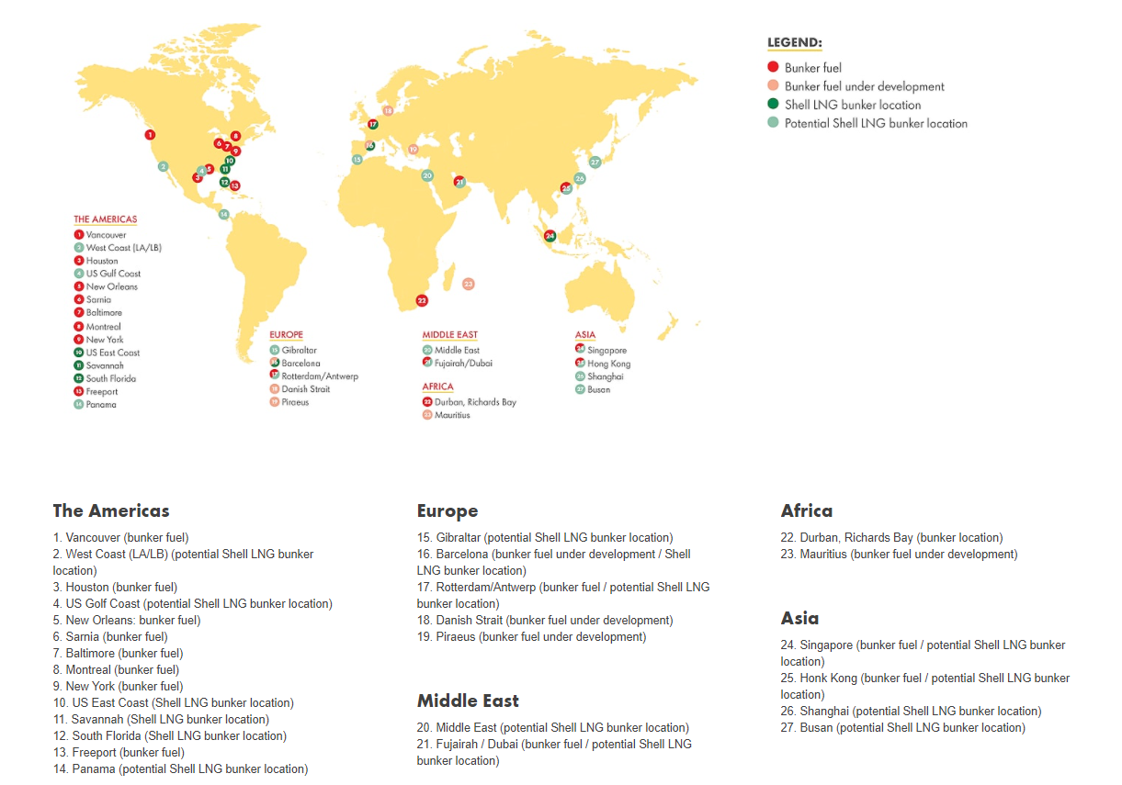
Shell Marine Fuels

Slide 28
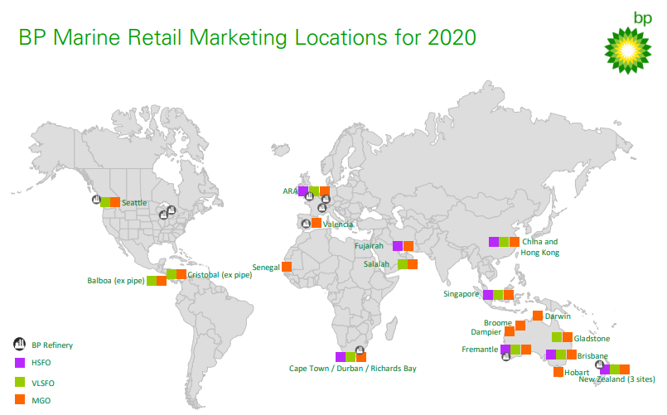
BP Marine Fuels

Slide 29
Exxon Marine Fuels

Slide 30
Refining

Slide 31
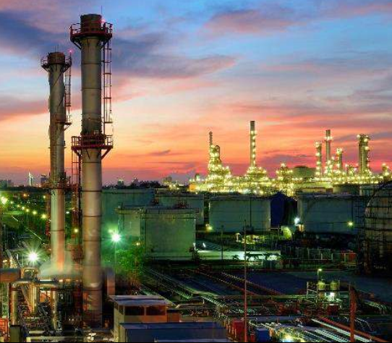
Refinery Market
Blending market is often associated with refineries that are processing a variety of oils, but also in refineries that are major hubs that handle a large variety of crude oils, condensates and other feedstocks
The two key processes that break down heavy oils are:
Hydrocracking
Coking

Slide 32
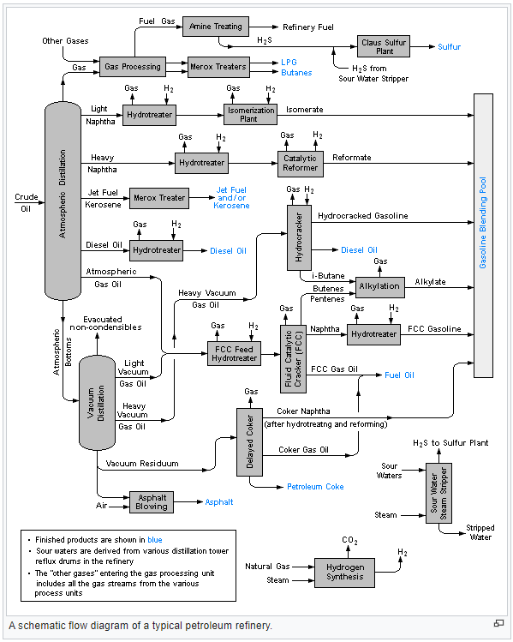
Refinery Flow Diagram
Treatment
Separation
Blending
Refinery Processes can be divided into 4 general areas
Conversion

Slide 33
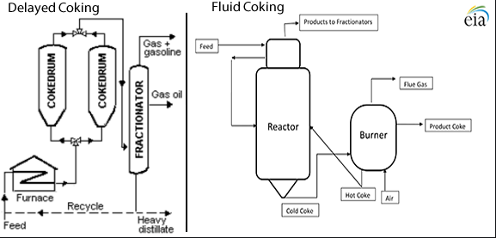
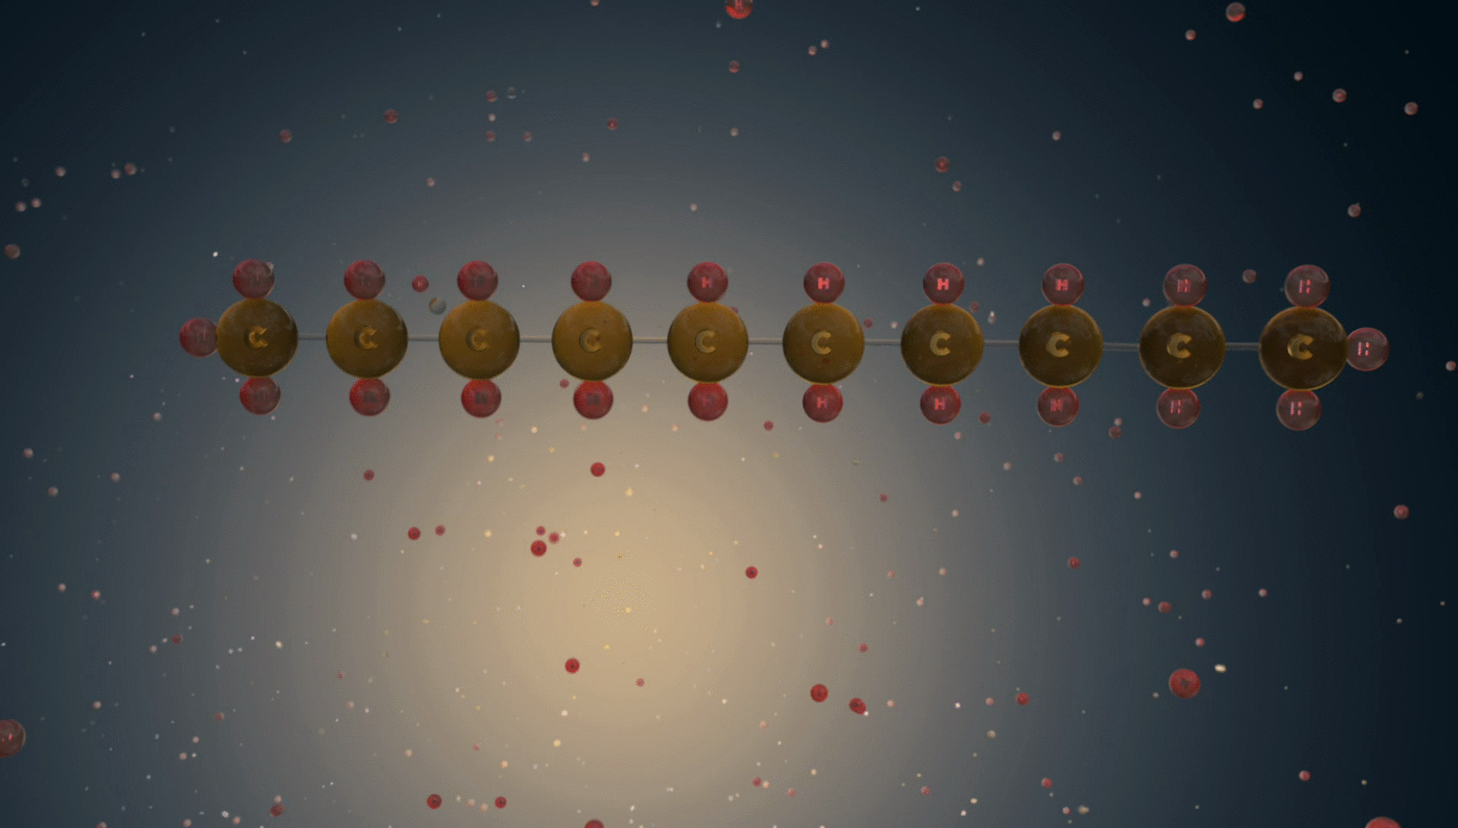
Cracking & Coking
Cracking
The term cracking comes from the process of breaking up long hydrocarbon molecules (using thermal processes) into smaller, more useful molecules. The cracking process uses heat (450°C to 750°C) to convert heavy straight run liquids into more useable products
Coking
Coking is the most severe thermal process (above 600°C) used in the refinery to treat the very bottom-of-the-barrel of crude oil, like ultra-heavy oils and bitumen.

Slide 34
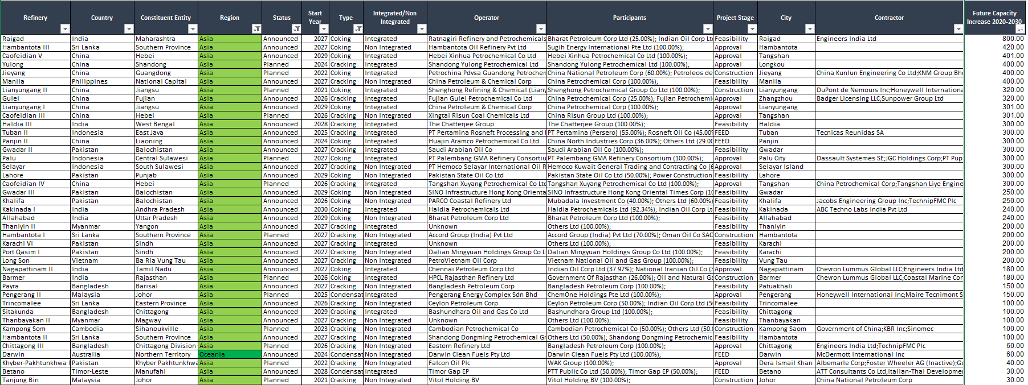
Asia Pacific

Slide 35
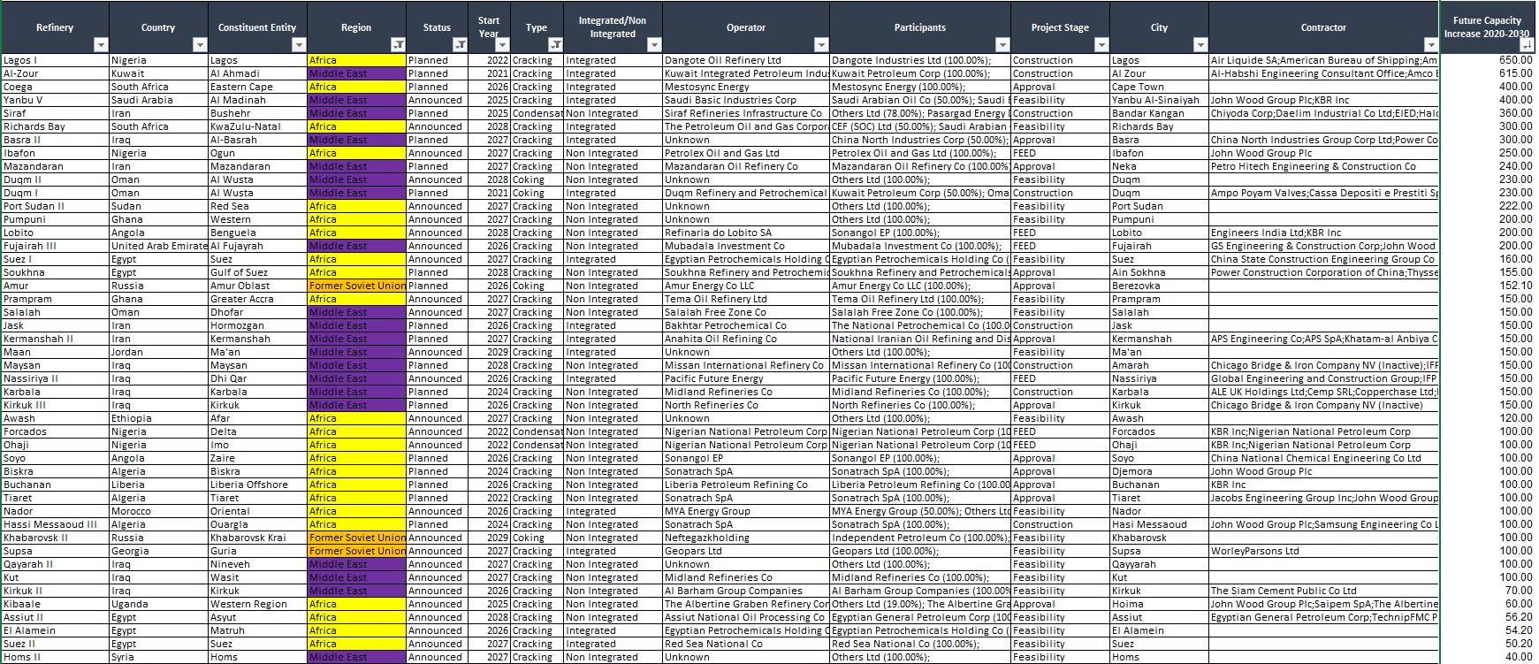
EMEA

Slide 36
NAM

Slide 37
LAM

Slide 38
Questions

Slide 39
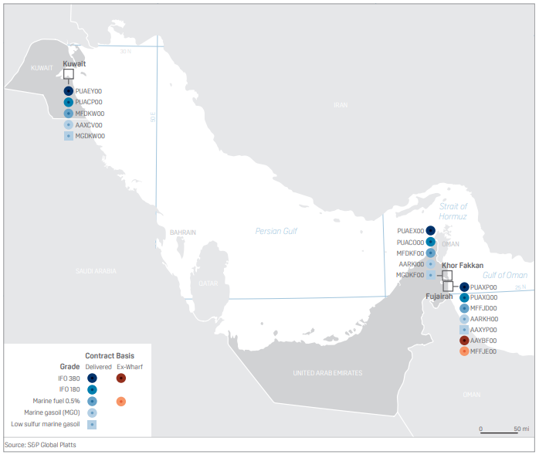
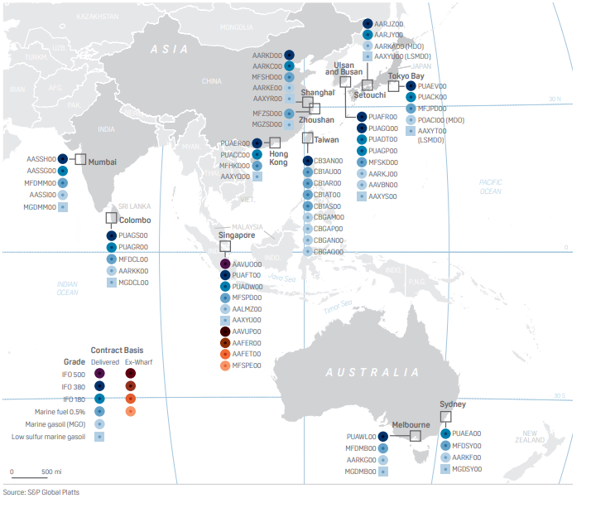
Supplementary Bunker Info (AP)

Slide 40
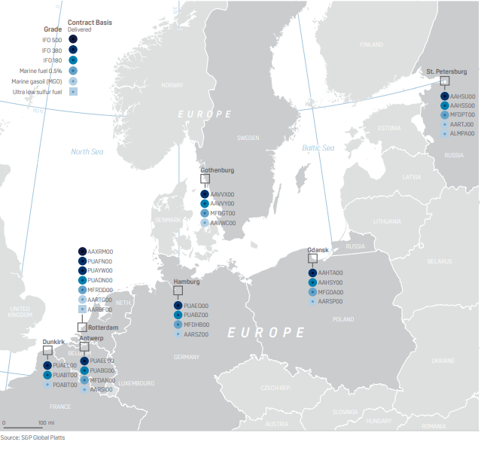
Supplementary Bunker Info - Europe

Slide 41
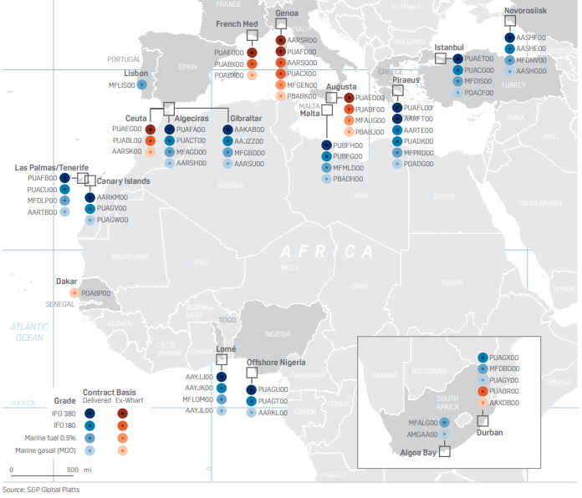
Supplementary Bunker Info - Africa

Slide 42
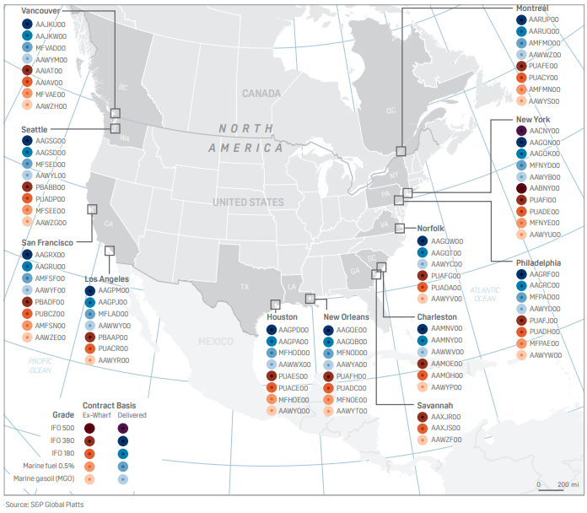
Supplementary Bunker Info - NAM

Slide 43
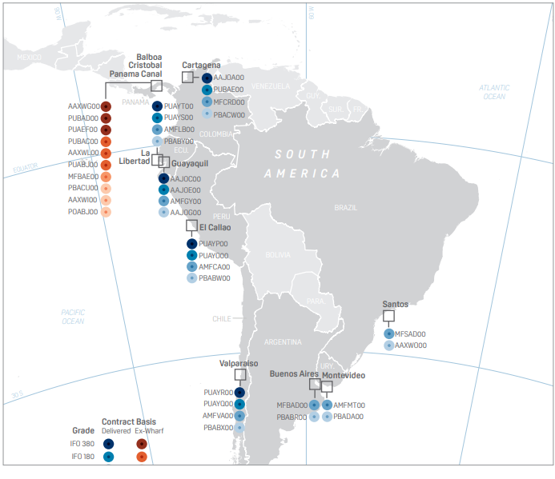
Supplementary Bunker Info - LAM

