Slide 1
Sensia Measurement
JISKOOT Blending Systems Training –
Week 2 Day 4
Duane Rowan – Product Champion

Slide 2
Blending Case Studies

Slide 3
Project Case Studies
Client: Confidential
Project: Confidential
Overview The world’s longest continuously heated and insulated pipeline
670 km 24" crude oil pipeline heated using SEHMS to
ensure the crude oil remains above the WAT of 65C
Only method of export for high wax crude
Two blending terminals
Terminal 1
Blended into receiving customer’s pipeline
Terminal 2
Blended into receiving customer’s different pipeline
Customer’s pipeline transporting domestic
and a wide range of imported crude at ambient temp.
Crude Oil Blending for Refinery
High Pour Point Crude Blending
Crude Blending Terminal
Bunker Fuel Blending

Slide 4
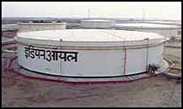
Crude Oil Blending – Overview of Indian Project
Throughput:
4000m³/hr – 6000m³/hr
Configuration:
Expandable fully integrated blender and control system
One 16” crude oil stream and one 24” crude oil stream
Mainline pump re-cycling and blend control
24” blend header
JetMix and viscosity analysis system
Viscosity at pipeline design reference conditions
InSight control system integrated to OMSS with SCADA
Ultrasonic flow meters
Fibre optic link to system to optimise installation cost
Performance guarantee 1% target viscosity
Crude Oils:
Heavy Crude Oils
Light Crude Oils

Slide 5
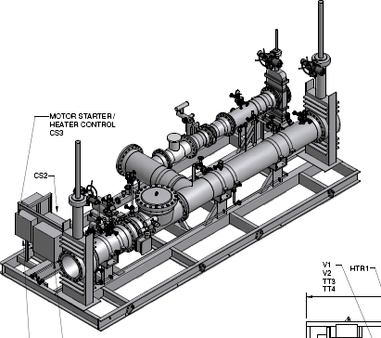
Crude Oil Blending - Details
Blend ratios: Heavy crude oils – 2% -35%
Imported 12cSt – 250cSt
Light sweet crude oils – 98% - 65%
Domestic or imported E.g. Basrah light etc - 8cSt – 36cSt
Mixing system JetMix with integrated dual analysers and temp stabilisation
Key design issues:
Blend imported and domestic crude oils to optimise cost
Maximise heavy crude usage with pipeline viscosity limits
Maximise throughput with continuous operations at all times
Absolute minimum pressure drop
Reduce pumping costs
Blender Status: Installed Q4 2012

Slide 6
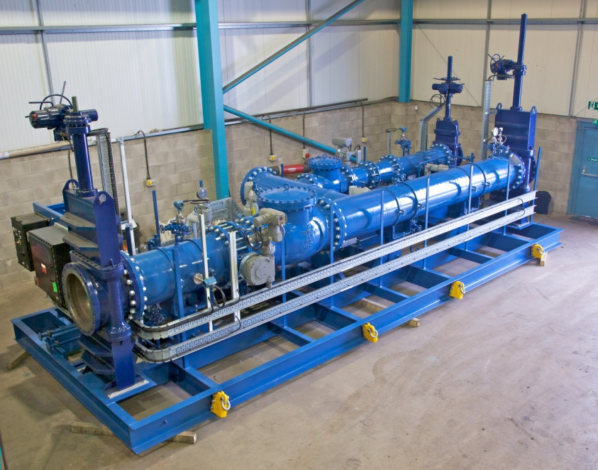
Blending System – Prior to shipment

Slide 7
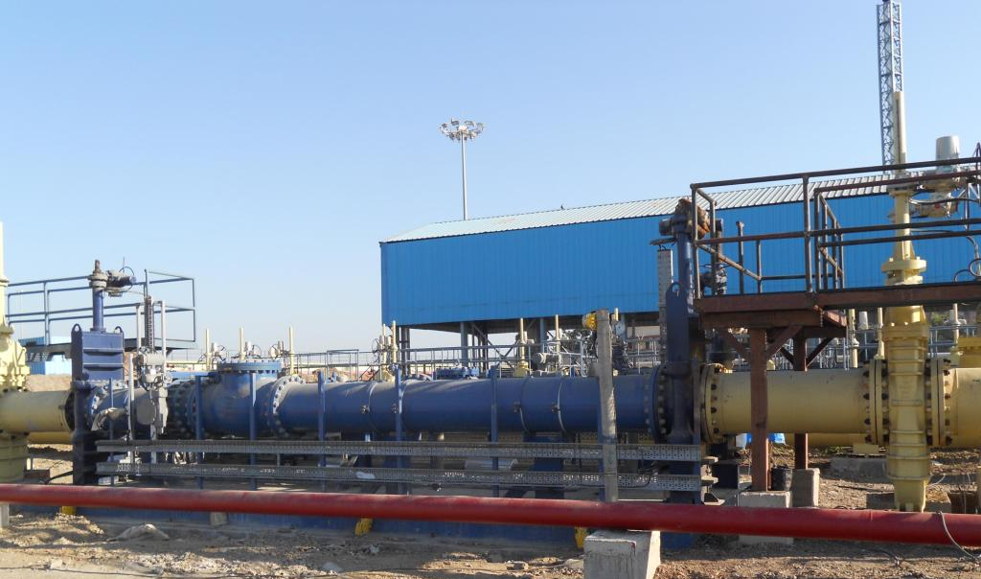
Blending System - Installed

Slide 8
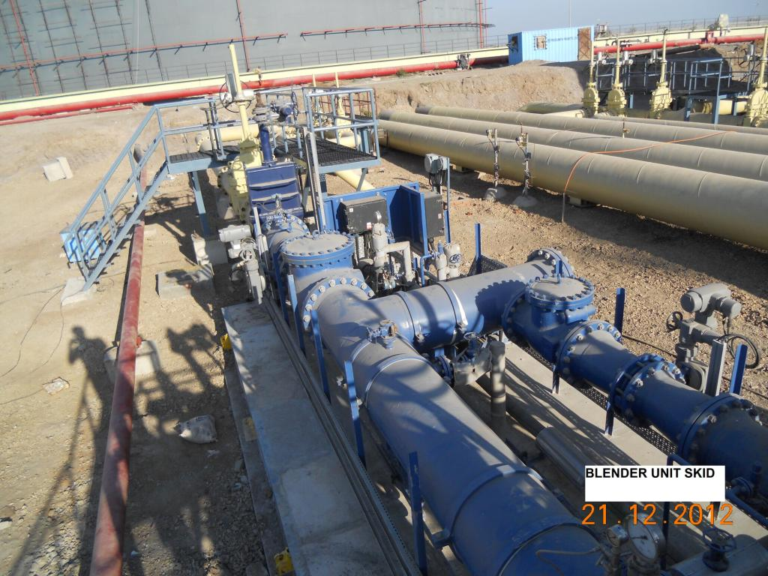
Blending System - Installed

Slide 9
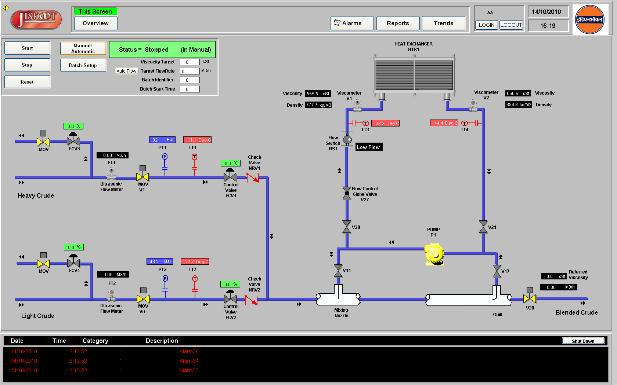
Blending System – HMI Interface

Slide 10
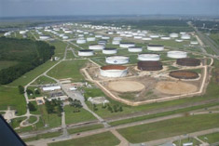
Nederland Texas Crude Oil Terminal Project
Client:
Confidential
Project:
Terminal major expansion
Overview
Crude oil, lubricants, petrochemicals terminal
19.6m bbl storage
8 docks/berths – 1mbbld capacity
2.1m bbl/d capability to refineries/pipelines
Blending 4 crudes from/to multiple locations
To meet quality parameters
Sulphur (0.18-0.20%)
Density
On-line watercut measurement
Business driver – increase use of sour and higher density crude oil to optimise cost of crude oil

Slide 11
Blend Matrix
Crude Type | Blend ratio | Rates
Sweet crude oil | 54-100% | 2750 – 7500bph
Sour crude oil | 1% to 8.5% | 50 – 600pbh
Local crude oil | 6% to 36% | 450 – 2500bph
Condensate | 4% to 25% | 200 – 1750bph
Blended Product |  | 500 – 7500bph
Crude Oils: Heavy Crude Oils
Light Crude Oils

Slide 12
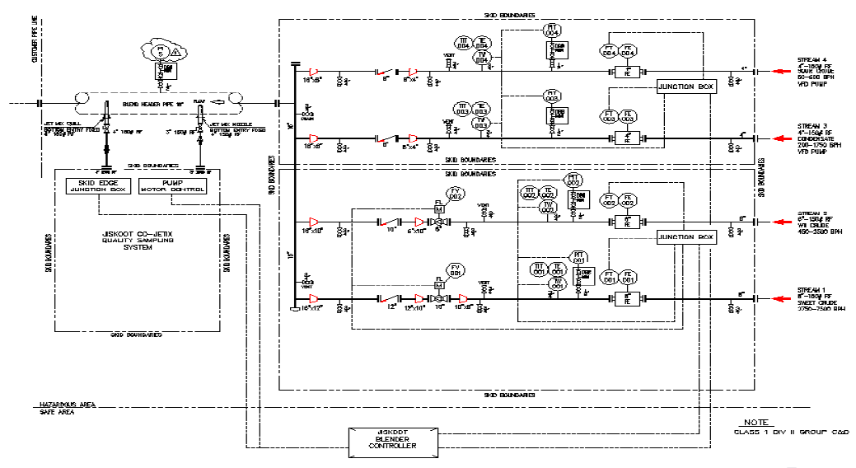
Application details
4 stream – 8 –path USFM
JetMix power mixing
Blend analysis and control
Sulphur - +/- 76 ppm
Density - +/-0.0001 g/cc
Watercut - +/- 0.04%
Integrated sampling
Low pressure drop
Dedicated blender control system
System performance guarantee

Slide 13
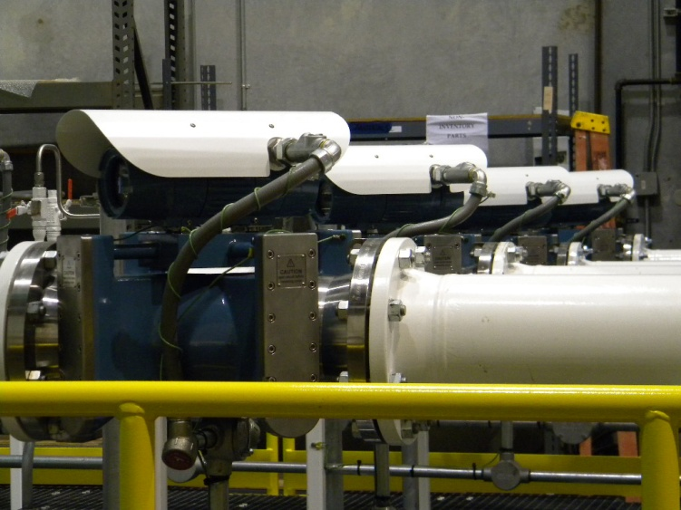
Blending System - Flow meters and blend streams

Slide 14
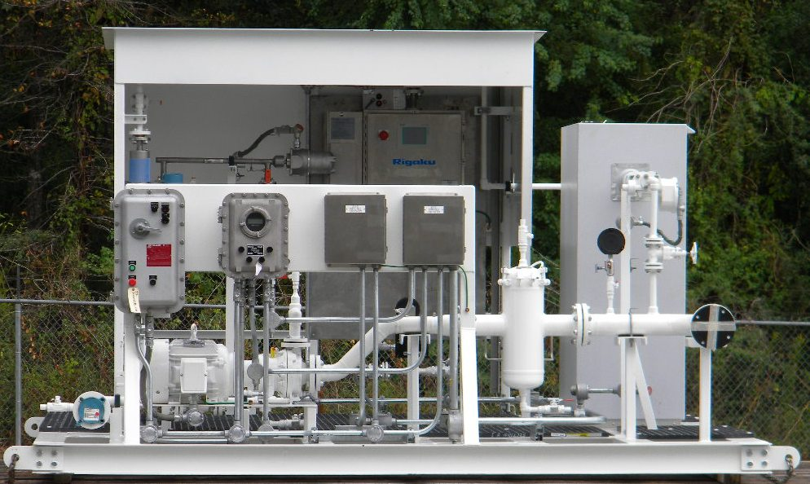
Blending System - JetMix + analyser system + Controller

Slide 15
Project case study – Overview Crude Oil Blender
Client: Confidential
Project: Refinery Greenfield Project
Overview:
New-build refinery designed to process 15mtpa of high sulphur heavy crude oil
Nil-residue production with a Crude and Vacuum Distillation Unit, a Hydrocracking Unit and a Delayed Coker Unit
One of the world’s most modern refineries
Start-up in Q4 2013
3 SBM for importing crude oil
Associated tank-farm and pipeline to another refinery location
Capability to blend directly to the refinery
Allow future capability to expand blender into another pipeline/refinery

Slide 16
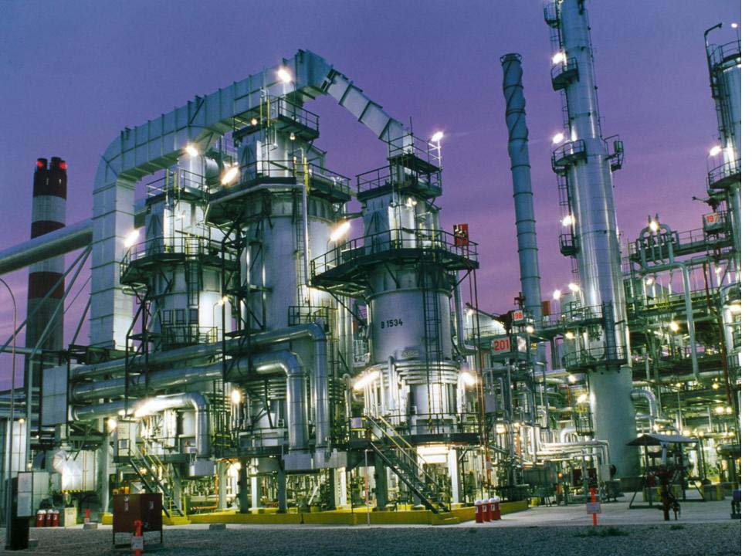
Blending Application - Overview
Required Throughput: 1000m³/hr – 2200m³/hr
Configuration:
Expandable fully integrated blender and control system
Five 16” crude oil streams
Tank farm pump flow re-cycling and blend control
20” blend header
JetMix and analysis system with Sampling, density and viscosity analysers
InSight control system integrated to OMSS
Ultrasonic flow meters
Comes with performance guarantee of 1% target viscosity and 0.2kg/m³ target for density
Calculated quality limits (ie TAN, Sulphur)
Crude Oils: High Sulphur Crude Oils
Heavy High Sulphur Crude Oils
High TAN Crude Oils

Slide 17
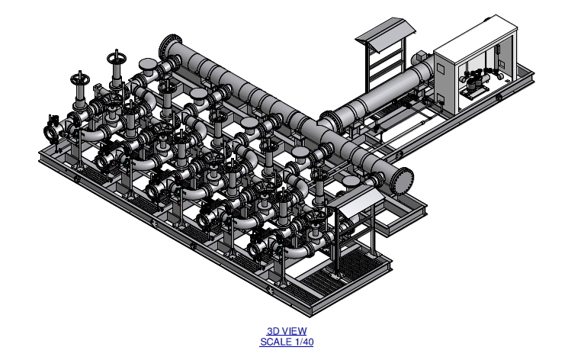
Crude Blending Application - Details
Blend ratios:
High Sulphur Crude Oils – 50-60% Kuwait etc. – API 29-34, Sulphur 1.8-2.6 % wt)
Heavy High Sulphur Crude Oils – 30-40% Maya, BCF-22, BCF-24, Merey, Soorosh, Nowrush etc
API 16-24, Sulphur 2-2.5 % wt
High TAN Crude Oils Kuito TAN : > 1.0 mg KOH/g
Key design requirements:
Blend imported and domestic crude oils to optimise cost
Process widest possible range of crude oils
Max flexibility with min pressure drop
Consistency and continuity of blend for the refinery
Blender Status: Installed on site Q3 2012

Slide 18
Blending Flow Control Skid
Meters to be installed on-site

Slide 19
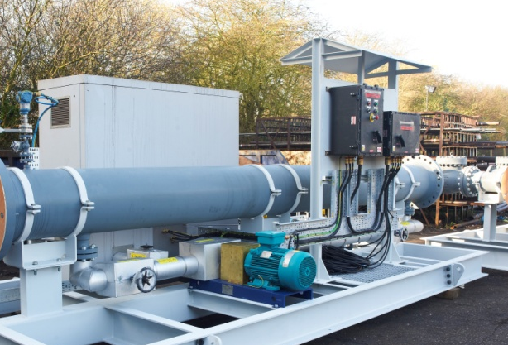
JetMix & Analyser Skid

Slide 20
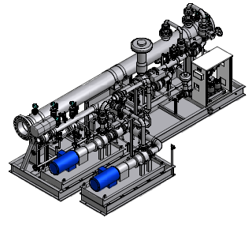
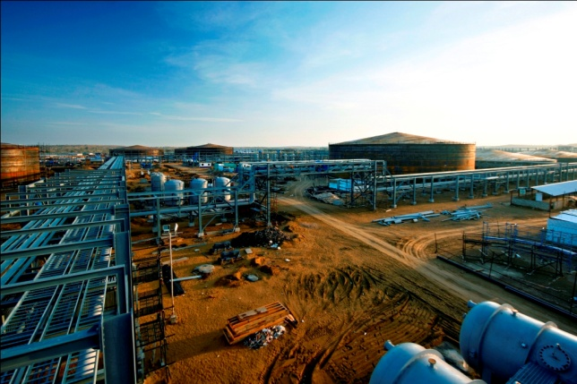
High Pour Point Crude Blending

Slide 21
Case Study - HPP Crude Oil Blending – India
The world’s longest continuously heated and insulated crude oil pipeline 670 km 24" crude oil pipeline
Skin Effect Heat Management System used to maintain pipeline temperature
Only method of export for high wax, HPP crude at two terminals.
Crude blended into an IOCL pipeline that feeds three refineries
Koyali (Gujarat)
Mathura (Uttar Pradesh)
Panipat (Haryana)
Customer’s pipeline network transporting:
domestic crude oils and a wide range of
imported crude oil at ambient temperatures

Slide 22
Case Study - HPP Crude Oil Blending
Goal
Accurately blend Heavy High Wax Crude with imported crude
Guarantee that it is mixed rapidly, consistently and evenly with no cold spots to cause waxing
Guarantee that at no point does the blend ratio exceed the compatibility ratio for the blend
Use on-line viscosity measurement as a check and control parameter to ensure that even if feedstock crude oil properties vary the design viscosity is not exceeded.
Ensure a failsafe control system to minimise risk of interruption to pipeline operations
Source the blender as a turnkey system from a reputable supplier with a track record of produced crude oil blenders

Slide 23
Case Study - HPP Crude Oil Blending
Blending design philosophy
Heavy high wax is directly blended into the clients pipeline using JetMix power mixing technology
Blender design concept ensures that it is not possible to exceed desired blend ratio at any point in the blending process as crude oil directly blended into pipeline
Mixing system adds high shear mixing energy to ensure rapid homogenisation at even temperature
Mixing energy added is constant regardless of the blending ratio of crude and will meet the 60-100% turndown of operators pipeline
Integrated analyser provides control feedback to keep blended crude on specification
Integrated physical batch blend sample extracted to verify blend quality
Control system features integral failsafe to ensure minimal risk in the event of

Slide 24
High pour point blender - Overview
Business Drivers
Pipeline
Transportability
Throughput/Pumping Efficiency
Need to meet tight specifications
Crude Compatibility Issues
Blending Philosophy
Crude compatibility
Can’t control
Process Envelope
Blend Control
System Integration

Slide 25
High pour point blender - Overview
Locations: Terminal 1 - Desert
Terminal 2 – Desert in receiving customers facility
Throughput: 950m³/hr – 1500m³/hr
Configuration: Fully integrated blender and control system
Installed in ‘flow-through’ configuration in main pipeline
Low pressure drop configuration downstream of mainline pumps
6” Mangala blend stream at 65C
18” main line and blend header at ambient temp
JetMix and analysis system with sampling and viscosity analysers
InSight blend control system
Ultrasonic flow meters
Failsafe limit control based on viscosity
IOCL pipeline operations
Crude Oils: High WAT Mangala
Imported Middle East crude oils

Slide 26
High Pour Point Crude – Engineering Details
Repeat order for two blenders for the same application
Blend ratios: Imported (low wax) crude oils – 95% - 75% E.g. Kuwait , Basrah light etc.
High wax Mangala crude oil – 5% – 25% Wax appearance temp 65C, re-dissolving temp> 90C
Mixing system Multi-nozzle JetMix high shear system to ensure homogeneity and no thermal layering Dual redundant configuration
Control system InSight blender control
Key design issues Ensure no wax deposition in receiving client’s main pipeline
Blend maximum Mangala % at point of sale
Failsafe if blend is over limits
Low pressure drop operation
Integration with IOCL operations
Blender Status: Terminal 1 – Commissioned - 2010
Terminal 2 – Commissioned - 2011

Slide 27
Terminal 1
Blender during installation

Slide 28
Terminal 1
Installed & Operational

Slide 29
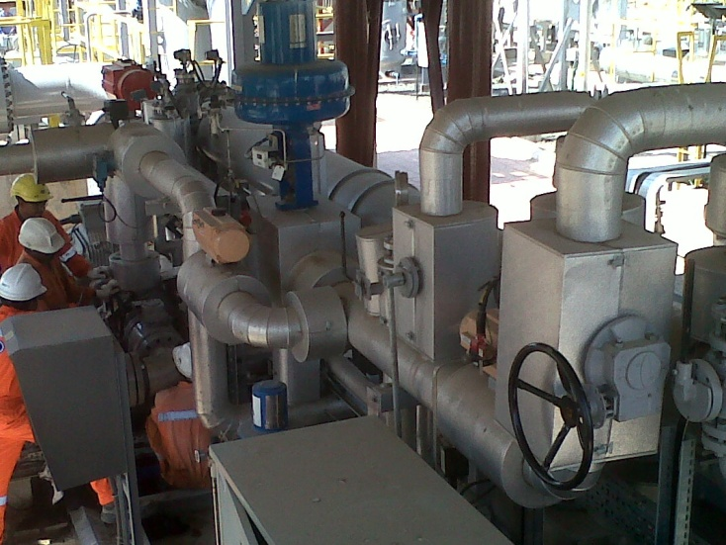
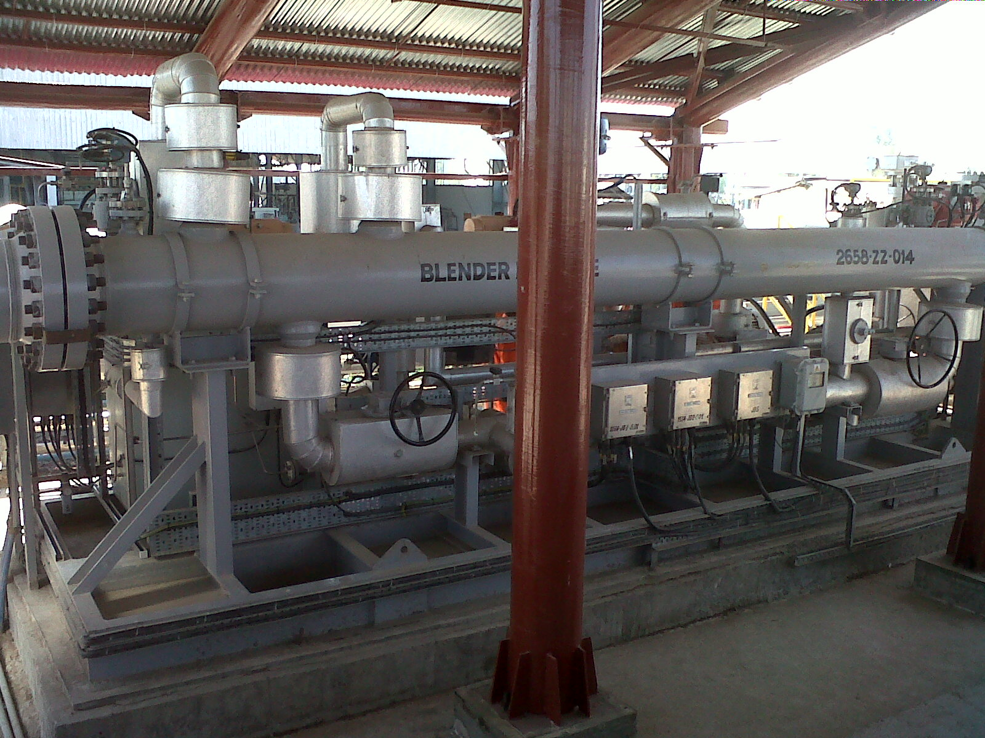
Terminal 2 Blender
Installed and operational

Slide 30
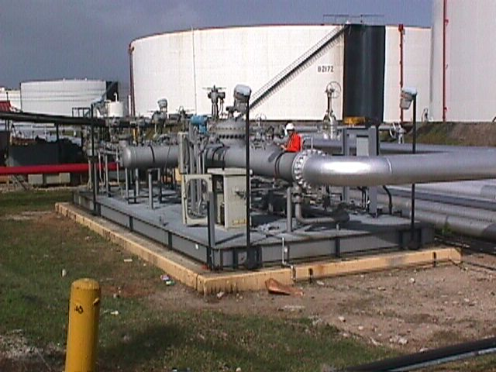
Success story - Bunker
Bunker blender in South America
400 – 3000 m3/hr
During commissioning
Target recipe
375cSt
Ratio
50%
26%
24%
HFO - 10480cSt
HGO - 208cSt
MDO -12.5cSt

Slide 31
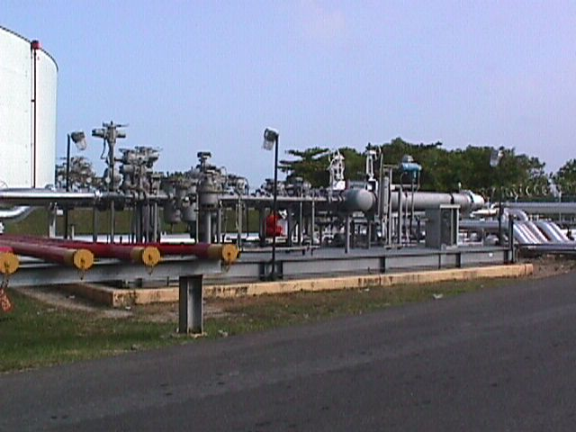
Success story
Initial run
Ratio
55.0% - 23.5% - 21.5%
MDO reduction of 3.5%
Final product
Ratio
57.1%
23.6%
19.3%
Reduction in MDO
24% - 19.3%
4.7%
$7-9/tonne cost reduction

Slide 32
Bunker Blenders

Slide 33
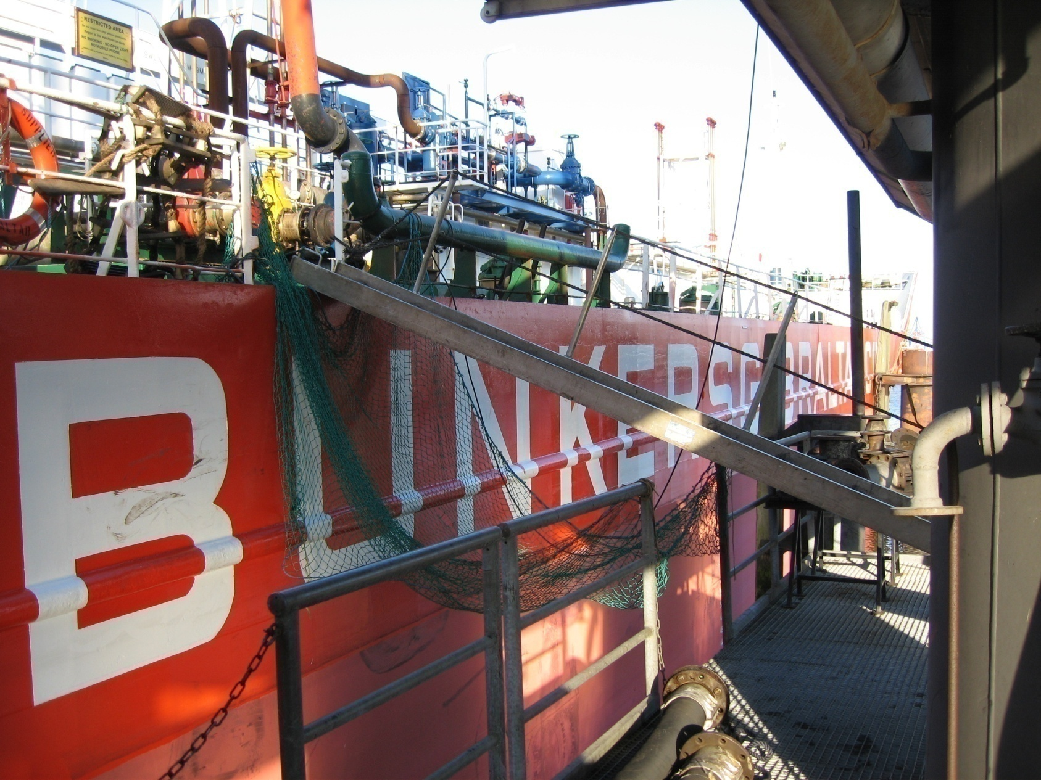
Fixed blender – Barge mounted – Bunkers Gibraltar

Slide 34
Mobile blender – BP Spain
Europe
Self contained trailer mounted blender
200 tonnes/hour
Pre-programmed & configurable blends

Slide 35
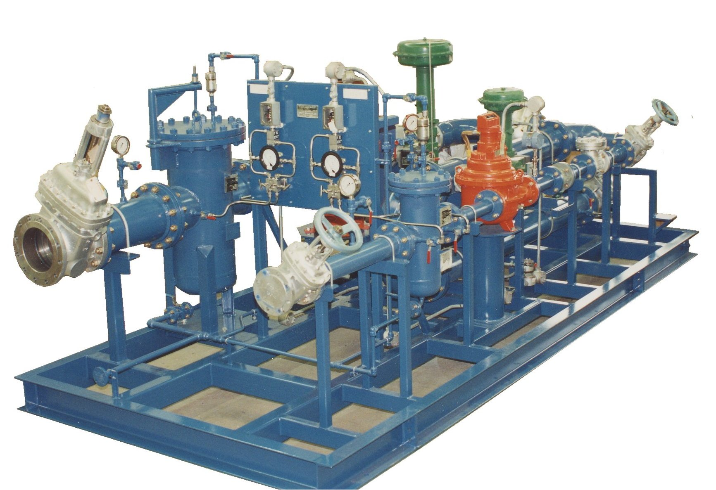
Fixed blender – terminal – Middle East
Northern Europe
Barge Mounted Blender
2500 bbl/hr
Pre-Programmed & Configurable Blends

Slide 36
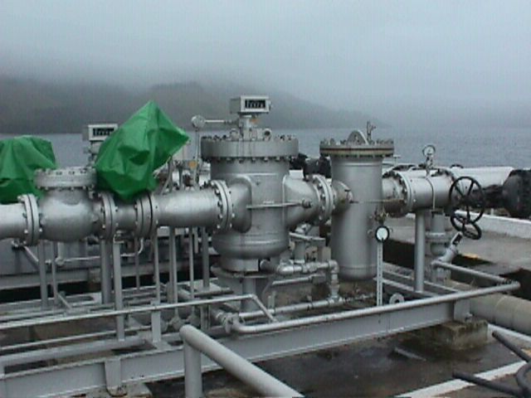
Fixed blender – Jetty – PDVSA
South America
2 x Jetty mounted blender
2500 bbl/hr
Viscosity Trim

Slide 37
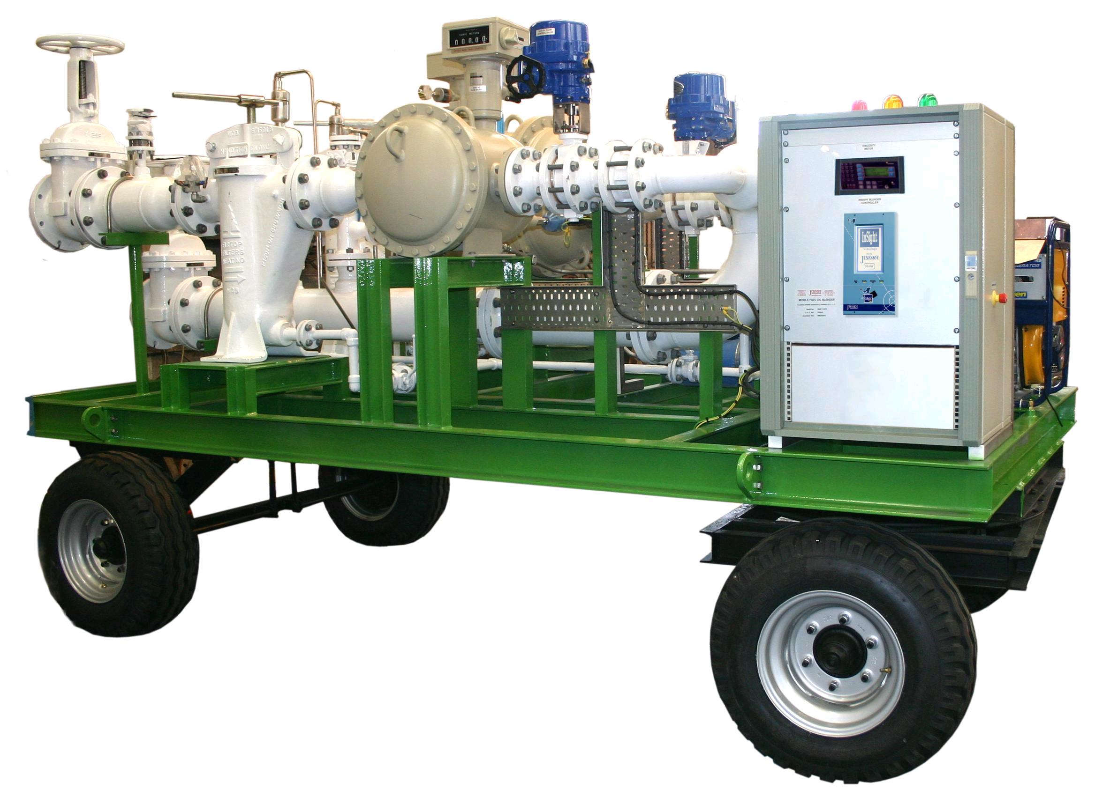
Mobile blender – Salalah port - BP
Middle East
Self contained trailer mounted blender
200 tonnes/hour
Pre-programmed & configurable blends

Slide 38
Fixed blender – terminal – South America

Slide 39
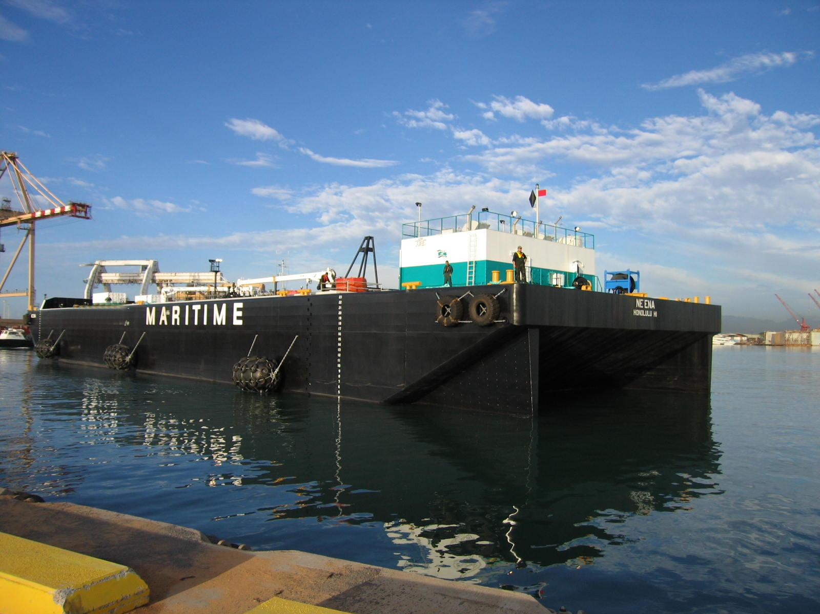
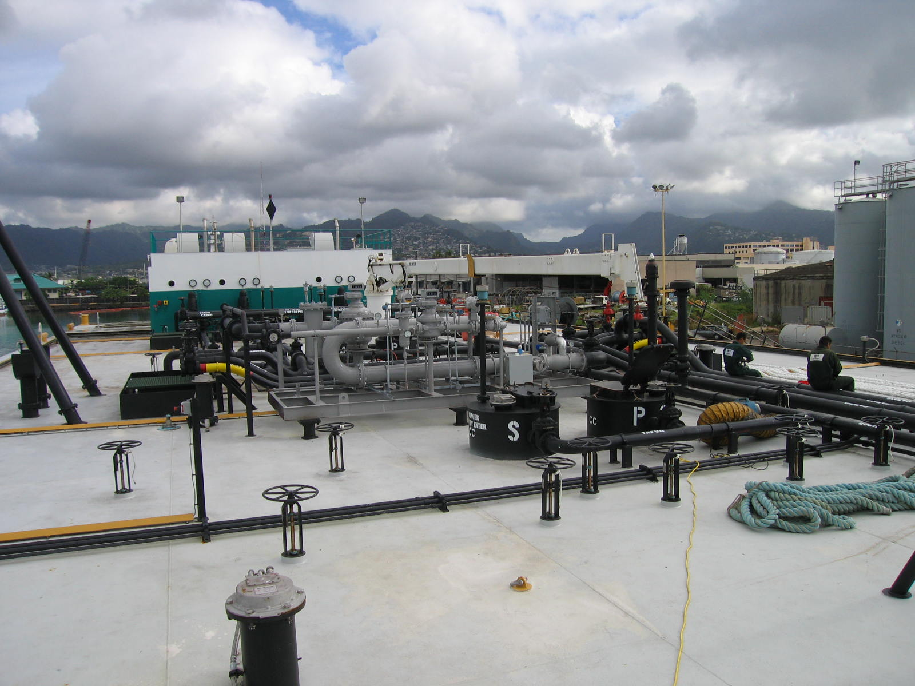
Barge blender – Smith Maritime - Hawaii

Slide 40
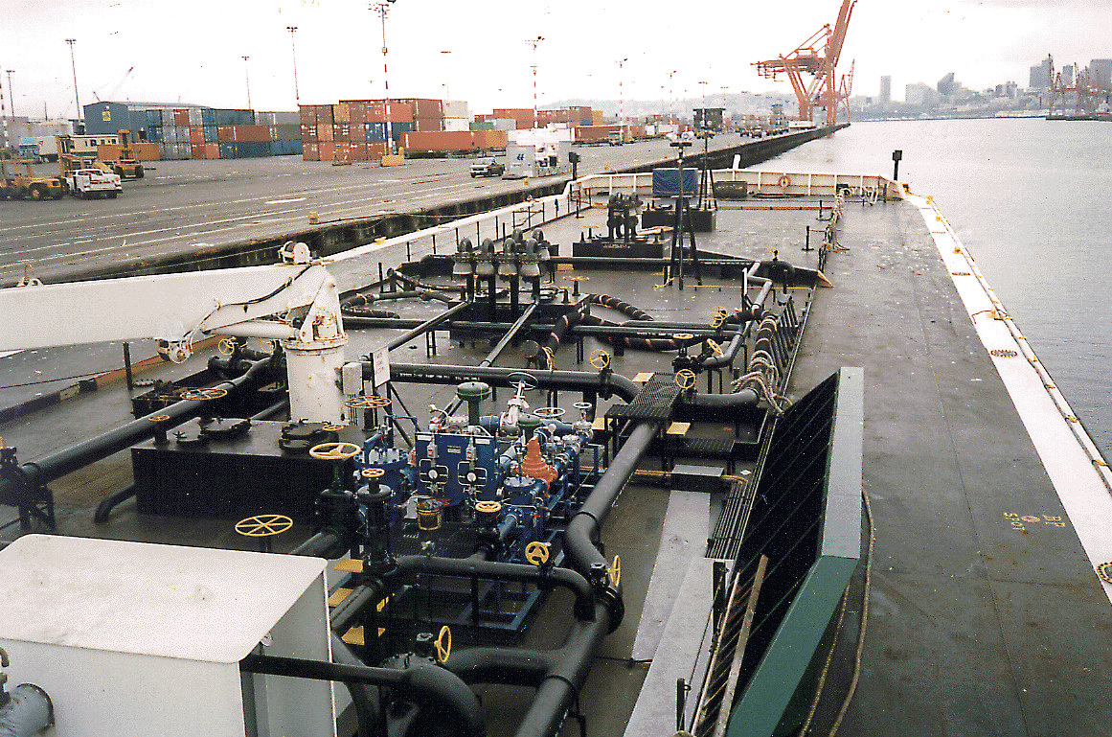
Barge Blender – Tesoro - Long Beach
Barge Mounted Blender
2500 bbl/hour
Pre-Programmed & Configurable Blends

Slide 41
Bunker Blender
PDVSA 2 Marine Bunker Blenders
Petrobras 5 Marine Bunker Blender
BP Marine 1 Marine Bunker Blender
UNOCAL 1 Marine Bunker Blender
Coastal Oil 1 Portable Bunker Blender
Texaco Panama 1 Marine Bunker Blender
Harbour Fuel Marine 1 Marine Bunker Blender
Patssa Panama 4 Marine Bunker Blenders
Bunkers Gibraltar 1 Barge Bunker Blender
Mueretta 1 Barge Bunker Blender
Fujairah Marine 1 Bunker Blender
Hangana Seafoods 1 Bunker Blender

Slide 42
Projects from the Past
Some recent projects
Bergesen Offshore/blending
Emarat Petroleum Terminal
Trafigura/Puma Terminal
Bunkers Gibraltar Bunker/Barge
FAL Energy Terminal
Petrobras Refinery
IOCL/IOT Paradip Refinery
PDVSA Terminal
Cairn India Crude/Pipeline
Keyera Wildhorse Butane/Terminal
Sunoco Terminal/
Suncor Bitumen/Pipeline
Oiltanking/MOGS Crude/Terminal
IOCL Vadinar Terminal/
MEASUREMENT

Slide 43
Questions

