Slide 1
SIS Technology
Scalable and Flexible Technology for Safety Solutions

Slide 2
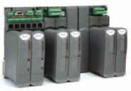
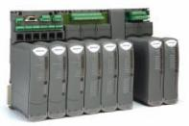
AADvance – Scalable SIS Platform
ICS Triplex, a company specializing in SIS Systems and Technology launched AADvance, a new generation of scalable SIS technology in 2007. AADvance was designed to complement Trusted by providing the ability to integrate the two platforms, offering unrivalled scalability.
Rockwell ‘refreshed’ AADvance by implementing EtherNet/IP, allowing AADvance to easily integrate with PlantPAx, Rockwell’s Process Automation solution.
With the scalable and distributed architecture, systems can range from 16 to >3000 I/O.
SIS Workstation is a suite of configuration and programing tools based on a Visual Studio shell.
Simplex
Dual
Triplicated

Slide 3
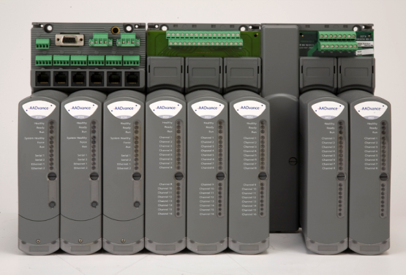
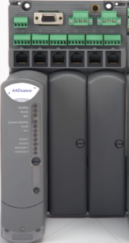
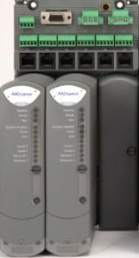
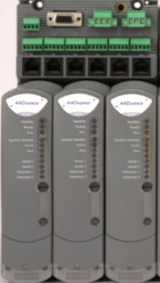
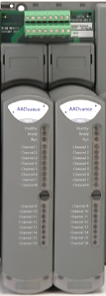
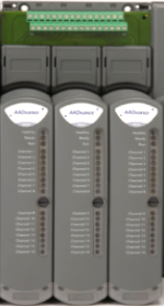
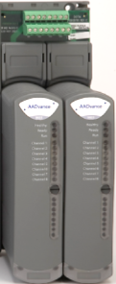
AADvance
AADvance is unique in the SIS Market for having both a Distributed and Scalable architecture.
Its distributed capability enables multiple controllers operating as a single SIS. Its Scalable architecture allows each controller to operate in Simplex, Dual, Triplicated or a mixture of configurations.
Processor Modules can be Simplex (Fail Safe), Dual or Triple Modular Redundant (Fault Tolerant), Communications are integral to the Processor.
Input (AI/DI) Modules can be Simplex (Fail Safe), Dual, or Triple Modular Redundant (Fault Tolerant).
Output (DO/AO) Modules can be Simplex (Fail Safe) or Dual Redundant (Fault Tolerant).
Non-safety
Systematic Capability (SC3)
Systematic Capability (SC3)
Systematic Capability (SC3)

Slide 4
Components of an AADvance System
I/O Base
Redundant
24v DC Power
Processor Base
Serial Ports
Ethernet Ports
Field Termination
Processor Module
I/O Module

Slide 5
Scalable Redundancy
1oo1 Fail Safe – For use in non SIS applications
TA
TA
I/P
CPU
O/P

Slide 6
Scalable Redundancy
1oo1/1oo2D Fail Safe – Certified for use in SIS up to SIL 3
TA
TA
I/P
CPU
O/P

Slide 7
Scalable Redundancy
1oo2D Fault Tolerant – Certified for use in SIL3 applications
1oo2D Fault Tolerant – Certified for use in SIS up to SIL 3
TA
TA
I/P
CPU
O/P

Slide 8
Scalable Redundancy
1oo2D Fault Tolerant – Certified for use in SIL3 applications
1oo2D/2oo3 Fault Tolerant – Certified for use in SIS up to SIL 3
TA
TA
I/P
CPU
O/P

Slide 9
Scalable Redundancy
1oo2D Fault Tolerant – Certified for use in SIL3 applications
SIL3 TMR Fault Tolerant applications
TA
TA
I/P
CPU
O/P

Slide 10
Input Architecture (Simplex AI)
TA
I/P Module
Processor
IO Driver
Logic
4-20mA
P
PV (1oo1D)
4-20mA
H
HART

Slide 11
Input Architecture (Dual AI)
TA
I/P Module
Processor
IO Driver
Logic
4-20mA
P
PV (1oo2D)
P
4-20mA
H
HART
H

Slide 12
Input Architecture (Triplicated AI)
TA
I/P Module
Processor
IO Driver
Logic
4-20mA
P
PV (2oo3)
P
P
4-20mA
H
HART
H
H

Slide 13
Input Architecture (Simplex DI)
TA
I/P Module
Processor
IO Driver
Logic
P
IP (1oo1D)
0-24V
H

Slide 14
Output Architecture (Simplex CPU/Simplex DO)
Processor
O/P Module
TA
24v A
Logic
IO Driver
24v B
CMD
A
D
1oo1
B
D
1oo1
1oo2D

Slide 15
Output Architecture (Dual CPU/Simplex DO)
Processor
O/P Module
TA
24v A
Logic
IO Driver
24v B
Logic
IO Driver
CMD
A
CMD
D
1oo2D
B
D
1oo2D
1oo2D

Slide 16
Output Architecture (Dual CPU/Dual DO)
Processor
O/P Module
TA
24v A
Logic
IO Driver
24v B
Logic
IO Driver
CMD
A
CMD
D
A
D
1oo2D
B
D
B
D
1oo2D
QUAD

Slide 17
Software Tools

Slide 18
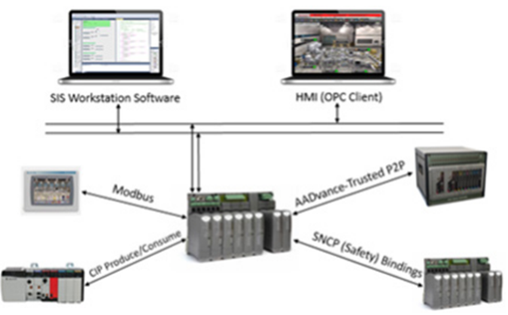
SIS Workstation
SIS Workstation Software is a complete design, configuration, and maintenance software environment.
SIS Workstation Software consists of a database editor (for managing variables and their attributes), configuration tools (for managing I/O modules and communications), language editors (for creating and maintaining application programs), compilers/validators (for creating validated application code for use in Safety Instrumented Systems) and a Simulator (for pre-testing code or modifications).
Rockwell developed the SIS Workstation to provide a single sustainable environment (Visual Studio) for both the AADvance and Trusted platforms, replacing older diverse software tools, while maintaining a migration path to the new environment.
SIS Workstation is a Certified tool (IEC61508-3:2010)
Four of the IEC61131-3 languages are supported (FBD, LD, ST and SFC).
SIS Workstation has built in compiler verification and static validators.

Slide 19
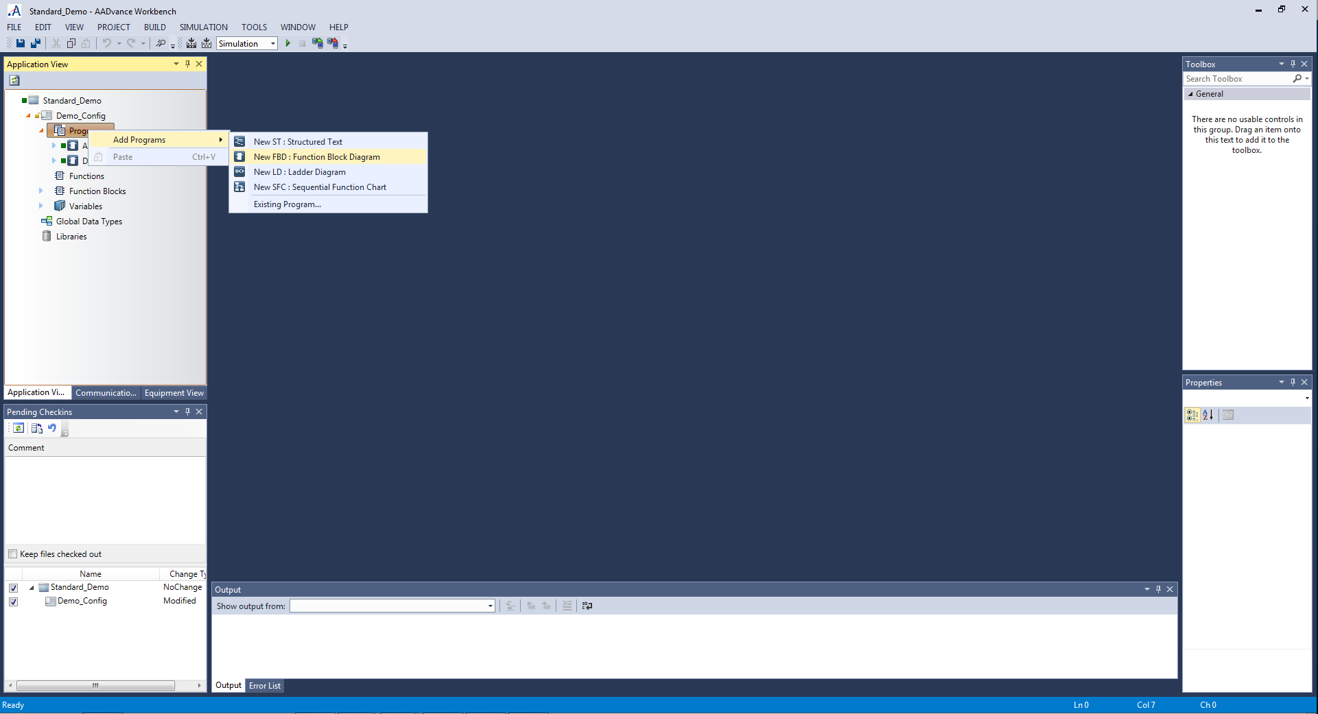
SIS Workstation - Languages
4 of the 5 IEC 61131-3 languages are supported.

Slide 20
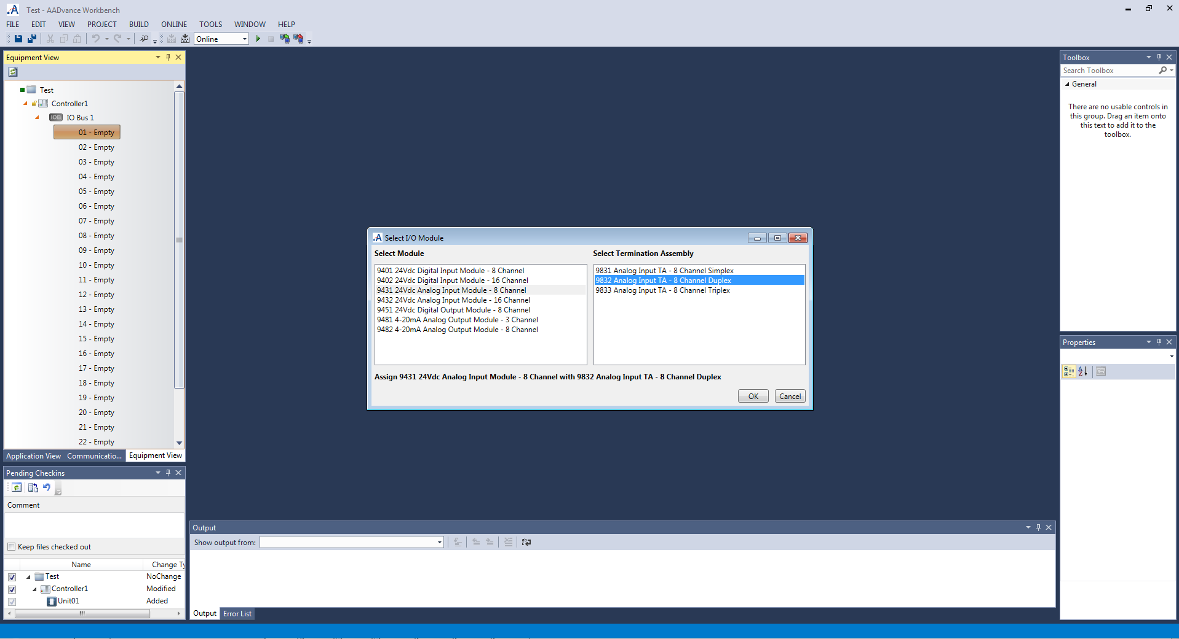
SIS Workstation – Hardware Configuration
Select Module Type and Architecture

Slide 21
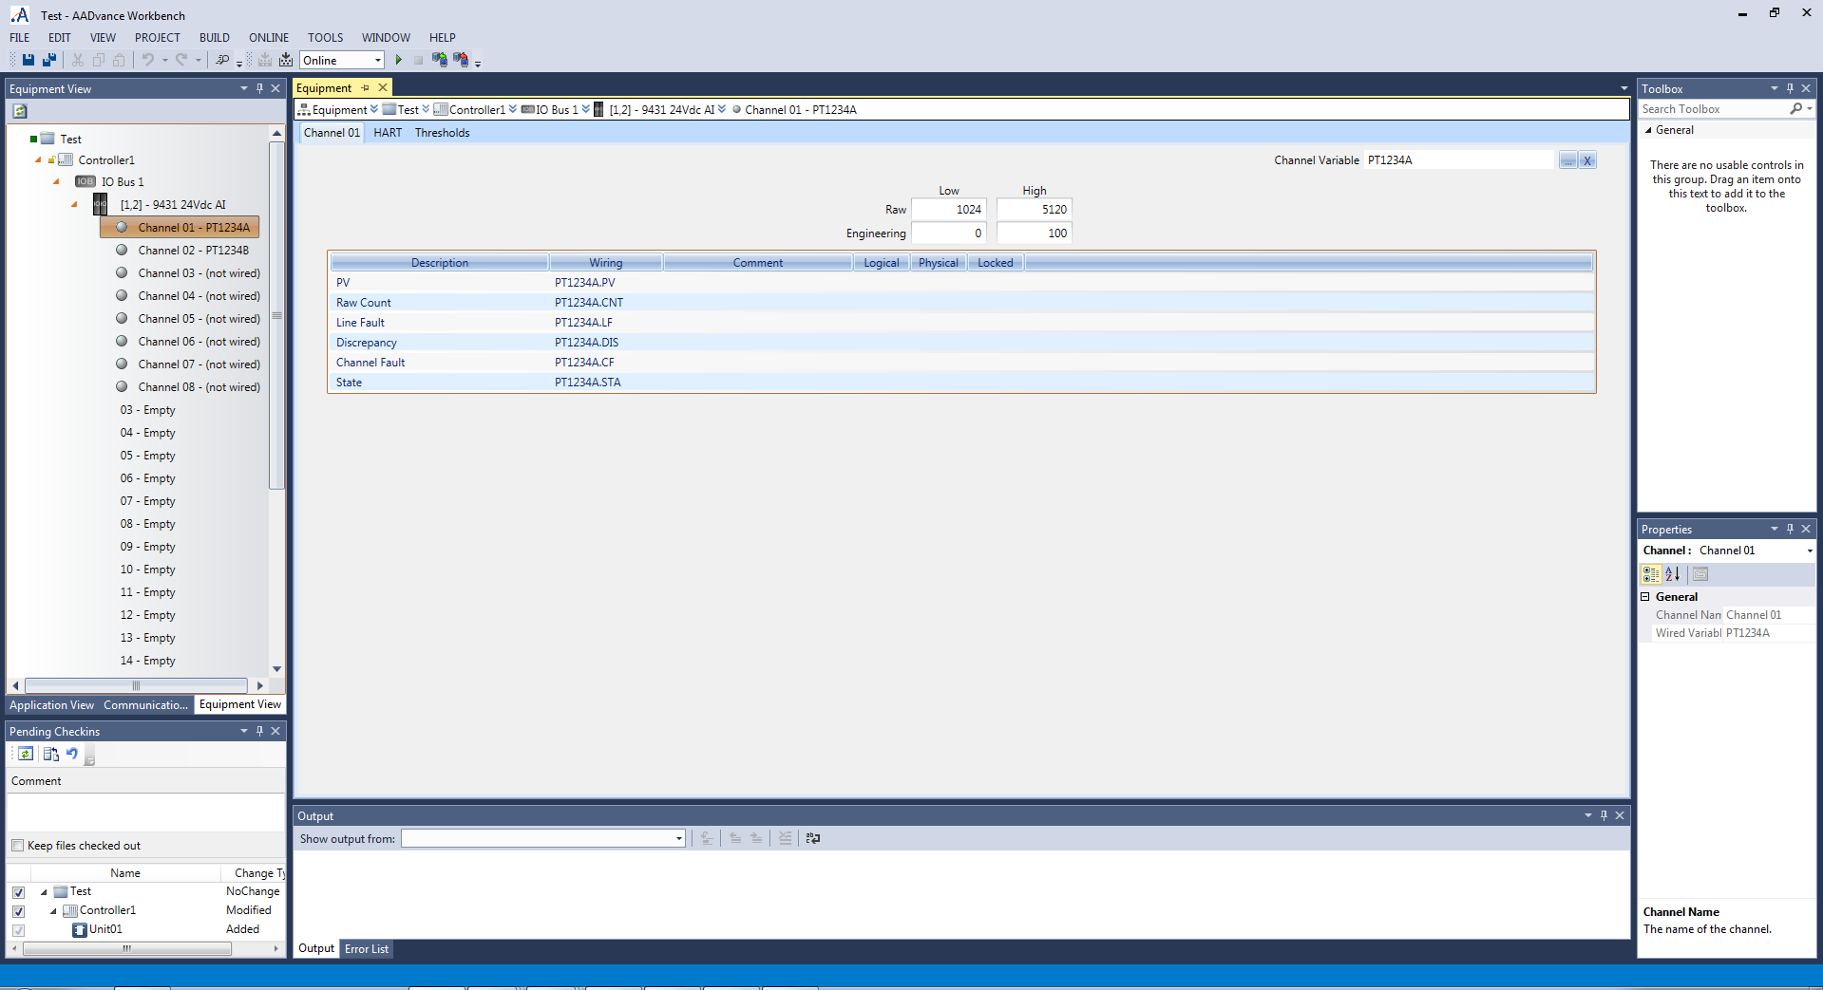
SIS Workstation – Channel Configuration
Connect a Field Device Tag

Slide 22
SIS Workstation – Channel Configuration
You can also configure device specific fault thresholds for Overange, saturation, open circuit etc.
Defaults follow NAMUR NE43

Slide 23
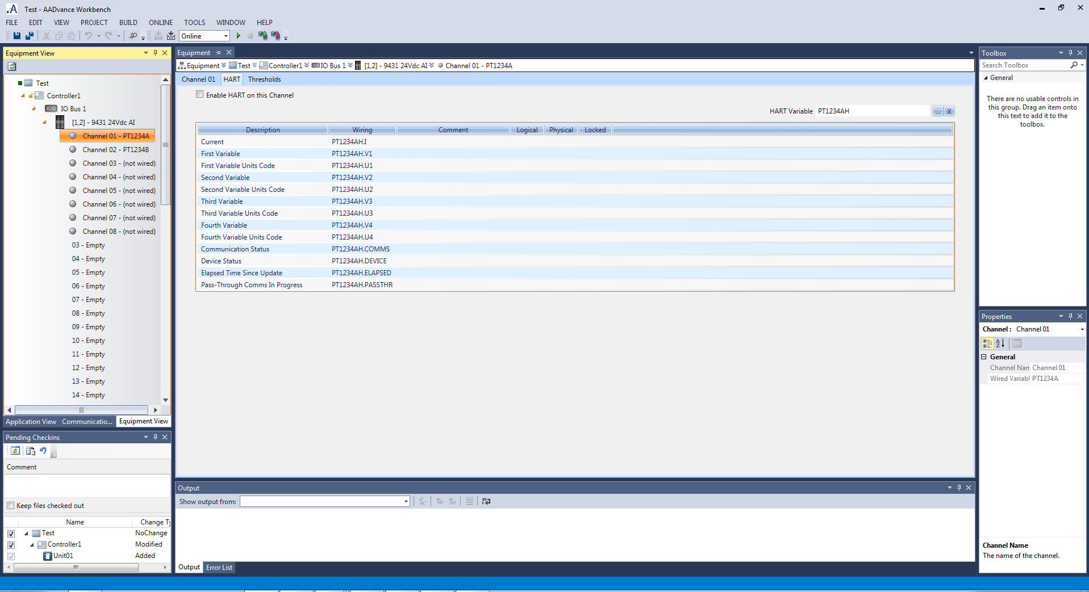
SIS Workstation – Smart Device Configuration
Assign a single HART Device Tag

Slide 24
SIS Workstation – Smart Device Configuration
You now have HART Data Providing:
Transmitter 4-20mA Current
Transmitter Process Value
Three Device HART Values
HART Status
HART Communication Status

Slide 25
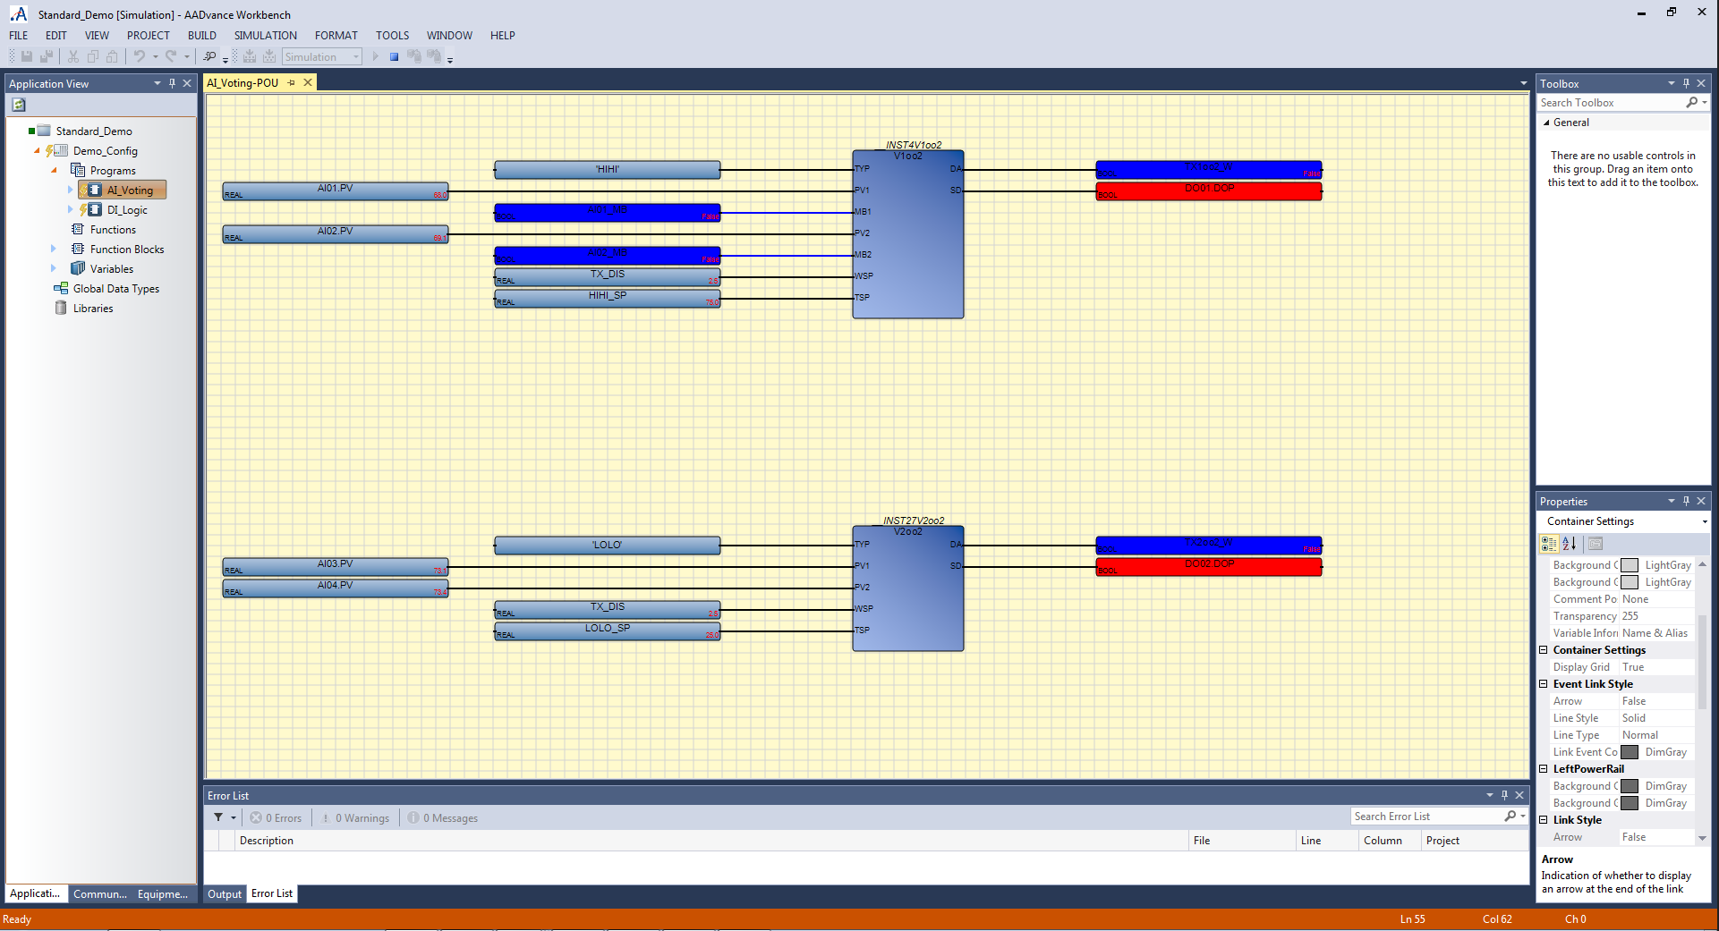
SIS Workstation – Simulation
Simulate & test programs offline!
Notes:
AADvance is configured using a workbench that supports all five IEC 61131-3 languages.

Slide 26
Solution Architectures

Slide 27
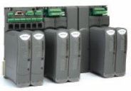
AADvance System Architecture
Workstation
Ethernet Safety Network

Slide 28
AADvance System Architecture
Workstation
Workstation
OPC Server
NAS

Slide 29
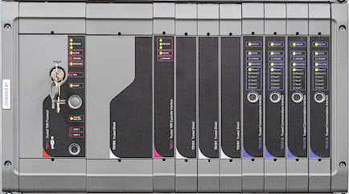
AADvance System Architecture
Workstation
OPC Server
Main
Chassis
Ethernet
Safety
Network
Autonomous Controllers, providing local protection, with overall facility management from the main Chassis

Slide 30
Features and Benefits
Flexible safety architecture to meet a wide range of Process Safety applications.
Distributed architecture, allowing local control at the process area.
IEC 61131-3 Programming environment, supporting four languages (validated for safety use).
Online modification:
Add, delete, and modify controllers online.
Add, delete, and modify I/O online.
Add, delete, and modify programs online.
Integrated HART on both analog input and output modules.
HART passthru, allowing HART device connectivity with FactoryTalk AssetCentre.
Two Ethernet ports built into each processor, up to six per controller (each with unique IP Addresses).
SNCP bindings for SIL 3 data between AADvance controllers.
CIP (Produce/Consume) integration.
OPC (DA & AE) integration with third party control and Operator Interface systems.
Modbus TCP (Master & Slave) communications available on each Ethernet port.
Two Serial ports built into each processor, up to six per controller.
Modbus RTU (Master & Slave) communications available on each Serial port.
Extended operating temperature range, -25°C (-13°F) to 70°C (158°F).
Conformal coated electronics as standard.
Class 1 Div 2, Zone 2, ATEX Hazardous area certification.

Slide 31
Summary
AADvance provides a unique approach to Process Safety, one where the application determines the solution architecture, rather than the traditional approach of making the application fit a pre-determined architecture.
AADvance has a scalable architecture that is unique in the marketplace. Its underlying hardware architecture allows inputs, processors and outputs to be configured in simplex, redundant (dual) or even triplicated arrangements, without adding any external components, wiring or additional programming.
AADvance offers a unique distributed architecture designed and TUV Certified to share safety interlock data between controllers over standard Ethernet networks. This distributed architecture allows engineering access anywhere on the network allowing logic in multiple controllers to be monitored concurrently from a single station.

Slide 32
Thank you

